Slide 1
Resource Management

Slide 2







Notes:
Game engines have to be able to manage a large number of different resource types;
Images
Text files
Configuration
Scripting
Language resources
3D Meshes
World / scene files
Levels
Environments
Audio
Sound effects
Music
Video
During development, it’s common for these files to change regularly – so the engine should be able to read them straight from the disk, many game engines also provide a way for the developers to package up assets into lump files (Quake loads pak files, Unreal uses upk files, some just use straight zip files)

Slide 3

Notes:
Trying to load all of these assets can be a lot like trying to cram everything you own into a suitcase – you’ll get so far and then you’ll run out of space, no matter how carefully you fold your pants and socks into intricate origami shapes.
The resource manager is the system that we build to try and guarantee that we can access the resources we need, when we need them, without trying to load everything at once.
It also provides an interface to the underlying file system so game programmers don’t need to do anything specific other than specify the asset to try and load, most resource managers will handle all (or at least, the majority) of the resource types that can be loaded.

Slide 4
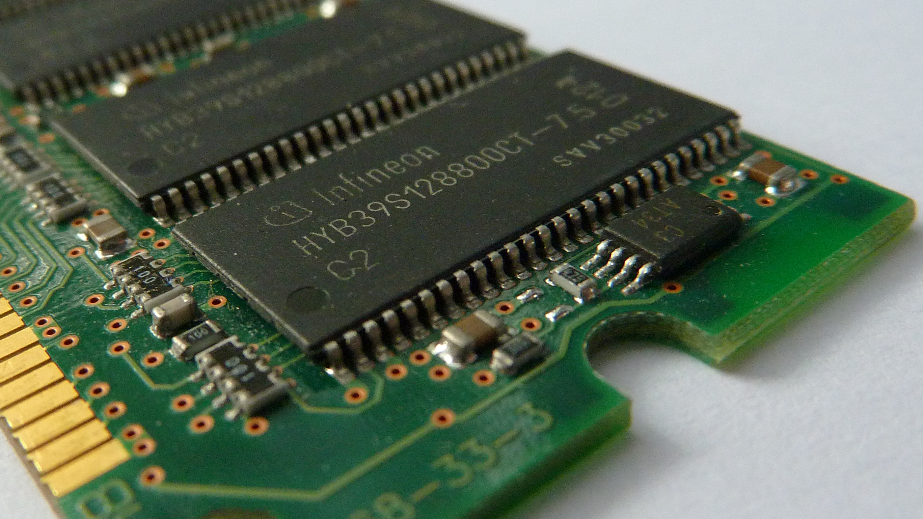
XBOX One
8 GB RAM
5 Actually available
Playstation 4
8 GB RAM
4.5 Actually available
Notes:
We need a system that will allow us to split our resources up somehow – preferably into resources that are required all the time, as soon as the game loads and those that we can load / unload as when they are needed (while loading a level).
Why is this necessary?
Modern consoles offer us up a good chunk of RAM, or so it seems at first. Both the Xbox One and PS4 have 8GB in the box, but their OS has to take up some space, for the Xbox that’s 3 gig, for the PS4 it’s 3.5 (though developers can sometimes claim up to 1 gig of that back from the system… sometimes)
PC’s can (and often do) have significantly more memory in them than their console brethren, but, how much of that is actually available is much harder to gauge – what the user has open will impact what’s available to our game!
So let’s aim for 4GB, how much can we fit in there?
Text files take up a byte per character, so 1024 characters of text is 1KB – it’s estimated that there are about 1.7 million words in the entire Game of Thrones series, with an average of 5 characters a word, that gives us about 8.8 million characters or 8642 KB, so about 8 megabytes, so about 500 copies of the entire series.

Slide 5

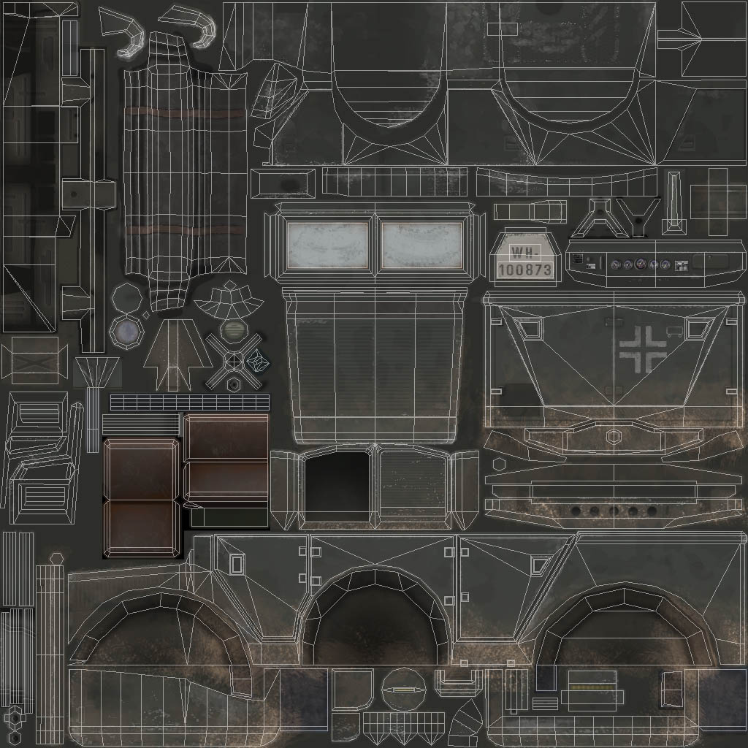


XBOX One
8 GB RAM
5 Actually available
Playstation 4
8 GB RAM
4.5 Actually available
x500
x1000
x100
2.5%
Notes:
So let’s aim for 4GB, how much can we fit in there?
Text files take up a byte per character, so 1024 characters of text is 1KB – it’s estimated that there are about 8.8 million characters (in both senses of the word) in the entire Game of Thrones series, so roughly 8642 KB worth, or about 8 megabytes, meaning we could keep 500 copies of the entire series in memory.
A 1024 x 1024 texture file that’s uncompressed takes 3- 4 MB (3 without an alpha channel, 4 with) so we could store about 1000 texture files in memory.
An uncompressed audio track, at 44.1 KHz and in 16 bit stereo is roughly 10MB a minute, so a typical 4 minute song is 40 MB, so just 100 tracks would fill the space.
A pre-rendered video is a killer, an 800 x 600 frame is 1.37 MB and we need at least 24 of them a second, so 33 MB a second – a minute of video suddenly takes up nearly 2 gigabytes of space, so 2 minutes of video overfills our RAM and leaves no space for audio…

Slide 6
XBOX One
8 GB RAM
5 Actually available
Playstation 4
8 GB RAM
4.5 Actually available
x500
x1000
x100
2.5%
Notes:
Great, that seems like plenty of space… a thousand textures?! Loads!
Except, we need to load these things all at once – in modern renderers, we might need at least 3 textures per mesh (diffuse, normal, specular) and there could be hundreds of meshes in a single level.
The level itself takes up space too, so that eats into our RAM, so does the music track we’re playing over the top of the gameplay and we might want a few of them over the course of a level or for different action sequences. Then we have all the sound effects too.
Each mesh also takes up space, we have to store the vertex data (x, y, z at 4 bytes each * thousands), the uv information and any animation data (which could be another 10 megabytes per animated character)
As we’re rapidly discovering, 4 gigabytes of memory is not a lot for a modern game, so we need something that’s going to handle our assets in a sensible fashion.

Slide 7

Offline Resource Manager
Unprocessed Assets
Resource Database
Runtime Assets
Notes:
Resource managers tend to have two sides, online (or runtime) and offline.
The offline side of the manager may link into a tool chain for the processing of files to modify a format produced by artists and turn it into a format more easily read by the game engine, or serializing human readable files into binary ones.
Ideally, it will track the integration of assets and store them in some form of database, which also stores metadata about the resources that describe how the resource should be processed.
So information like the type of compression to use for a texture, the range of frames to process from a file containing animation or which mesh corresponds to which character or object in the game.
This process can be automated, so the resource manager watches the asset collection and picks up new or modified files and triggers their offline processing – assuming the correct metadata is in place.
The metadata can be as simple as a small text file that contains the information or it could be stored in something as large as a full blown relational database such as MySQL or Access.

Slide 8
Offline Resource Manager
Unprocessed Assets
Resource Database
Runtime Assets
Notes:
Whatever shape it takes, the resource database should provide the following:
The ability to deal with multiple types of resources
CRUD (Create, Read, Update and Delete) resources
The ability to move a resource’s source files from one location to another on-disk
The ability of a resource to cross-reference other resources
It’s also useful if the database can maintain a revision history of the resources, with a log of who made each change (and why). The database could also support searching and querying in various ways – as a game grows, it becomes harder to track down specific assets, so being able to search is a huge help for developers.
Doing a resource database correctly is a huge job, but it can be all the difference between a game hitting its release date or one that just turns into yet more vapourware.

Slide 9

Notes:
The other side is the runtime resource manager, which needs to do a few things:
Track open files, so any further calls to load a resource won’t try and open it again
Manage the lifetime of a resource – so they’re not kept in memory when not needed
Loads needed resources and unloads them when they’re no longer required
Handles loading of composite resources – a 3D model contains a mesh, one or more materials, one or more textures and possibly a skeleton and related animations.
Maintain referential integrity – both internal referential integrity (cross-references within a single resource) and external referential integrity (cross-references between resources). A model refers to its mesh, a mesh refers to its materials, materials refer to their textures. The resource manager must ensure that all necessary sub-resources are loaded and it must patch in all of the cross-references properly.
It should also manage the memory usage of loaded resources

Slide 10

Notes:
Another issue we face is that as our game grows larger, with more and more assets, we find ourselves spending longer and longer waiting on file I/O requests – reading from a hard drive is slow, even a “fast” platter based drive will cause the CPU to wait for up to 2ms for a piece of data to be located on the disk and the I/O operation to actually begin. The drive has to spin up to speed, the read head has to move into the right location and then become stable enough to actually read the data… that’s slow!
Optical drives are even slower, the laser moves at a constant linear velocity along the spiral that contains the data on a CD – so depending on where the data we want to read is physically situated, the longer we have to wait and there’s nothing we can do to speed it up.
So if we’re constantly trying to read files from our storage device (even an SSD drive is slow in comparison to a modern CPU), we end up making the machine hitch and halt as the various bits of data are read into memory for us to work with. This is an even bigger nightmare if they’re stored in different places on the physical storage (so at the other end of the CD or a completely different part of the HDD platter), each read makes us wait and that slows down things like load times.

Slide 11
Common Data
Player Assets
Menu Assets
Shared Textures
Shared Audio
Level 1 Data
Level 2 Data
Level 3 Data
Notes:
All this means we want to minimise our read requests, we wait until we have a list of things to retrieve from storage and we do it all at once (much like Christmas shopping) – rather than popping out and picking up pits and pieces as and when we feel like it. The best solution is to make sure that everything we might look for at a given time (say, loading a specific level) is contained in a single block of data, but the perfect approach requires us to have repeated data, as there will be some thing that are common to all levels (the player graphics, certain elements in the world). So a better approach is to break our data up into logical blocks, we might have one that contains all the common elements and then individual blocks for unique elements that appear on a per-level basis.
So even if we have hundreds of assets in a level, we’re only doing two seeks – one for the common block file and another for the level specific block. Doing this also means we can do things like compressed the large blocks, allowing us to fit more on our storage medium, there is a trade off between space saved and then the processing cost of decompressing everything, but it can be worth it.
The most common approach to these sorts of bundled resource collections is to effectively reproduce a filesystem in a file, so once loaded, it’s all organised as if we’re reading it from physical storage rather than RAM.

Slide 12

K.I.S.S.
Text Files
Uncompressed Images
Compressed Images
WAV Files
OGG Files
Notes:
Having said all that, when starting out – keep it simple, stupid!
The engine you’re developing for this module probably does not need a full blown resource management implementation.
Focus on a runtime manager that can load a controlled (ie, small) number of asset types:
Text files
JSON or XML for configuration and world data
One or two image formats
Uncompressed – TGA or BMP
Compressed – DDS or PNG
Audio files
Uncompressed WAV
Compressed OGG (MP3 requires a license fee)
You don’t really need to even write the code that will load those files – libraries exist that will do that for you, though it’s never bad practice to at least write a few simple file parsers.

